Slide 1
Madhav Murthy, Assistant Professor, Dept., of Mechanical Engineering B.M.S.College of Engineering, Bengaluru
Customer Relationship Management

Slide 2
CRM is a customer-focused approach to business based on fostering long-term, meaningful relationships.
CRM is not about immediate profit. It’s about the lifetime value of a customer – the purchases they will make in future, the positive word of mouth they will generate on your behalf and the loyalty they will show your brand.
Effective CRM enables businesses to collaborate with customers to inform overall business strategies, drive business processes, support brand development and maximise ROI.

Slide 3
Key terms and concepts
Customer : A person who buys or uses goods or services, with whom a company should develop a relationship.
Customer-centric : Placing the customer at the centre of an organisation’s business planning and execution.
Customer-driven : Allowing and encouraging customers drive the direction of a business.
Customer lifetime value (CLV) : The profitability of a customer over their entire relationship with the business.
Customer relationship management (CRM): A strategy for managing a company’s relationships with clients and potential clients. It often makes use of technology to automate the sales, marketing, customer service and technical processes of an organisation

Slide 4
Data: Statistics and facts collected for analysis.
Data mining: The process of analysing data to discover unknown
patterns or connections.
Key performance indicator (KPI) : A metric that shows whether an objective is being achieved.
Metric: A defined unit of measurement.
Model: A strategic visual representation of a process that a company adheres to.
Prospect: A potential customer.
Stakeholder: A person or organisation with an interest in how a resource is managed.

Slide 5
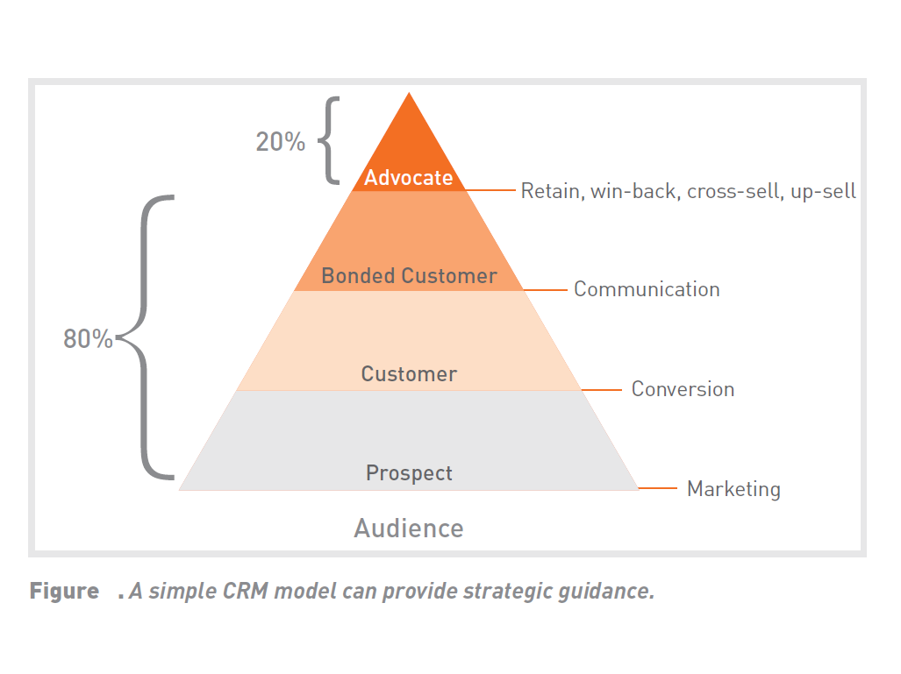
A CRM model A good CRM strategy turns strangers into customers, customers into friends, and friends into advocates for your business.

Slide 6
Understanding customers
CRM should not only mean implementing customer-centric processes and consider technology, but embracing customer-driven processes.
Through innovations in digital technologies, enhanced customer engagement and the introduction of mass personalisation, the customer can often drive the business.
Customer touch points
Customer loyalty

Slide 7
Customer touch points
Consumer touch points are all the points at which brands touch consumers’ lives during their relationship.
Touch points can be brand initiated (for example, a brand sending an email newsletter) or customer initiated (for example, the customer making a purchase in a store).
3 phases of Consumer touch points
Pre-purchase or pre-usage
Purchase or usage
Post-purchase or usage

Slide 8
Customer loyalty
Have a projected lifetime value that makes them a valuable prospect to your business.
Buy a variety of your products or use your services repeatedly during their time as a customer.
Share their positive experiences with others.
Provide honest feedback on these products and services, and their experiences.
Collaborate with you on ways to improve their experiences.

Slide 9
CRM and data
Data is central to the success of CRM initiatives.
Knowing who your customer is and what they want makes a CRM strategy successful.
But data on its own is meaningless if it is not analysed and acted upon. Through analysis, data can be turned into insights.
Eg: Purchase data – Offers

Slide 10
Customer data
Company should have a database - conducting surveys, focus groups etc.
Information should be commercially relevant.
Capture additional contact details from the customer at every interaction – on purchases, contracts, negotiations, quotes, conversations and so on.
Capture any information you send out to the customer.
Consider anything that adds value to the relationship.
Note any legal implications around capturing data, particularly web-based behavioural data, as the user’s privacy must always be taken into account.

Slide 11
Where and how to gather CRM data?
Traditional CRM system data
Demographic details on potential leads, current leads and contacts, such as age, gender, income, etc.
Quotes, sales, purchase orders and invoices (transactional data)
Psychographic data on contacts such as customer values, attitudes, interests, etc.
Service and support records
Customer reviews or satisfaction surveys
Web registration data
Shipping and fulfilment dates, such as when orders were shipped and delivered

Slide 12
Data mining
Data mining involves analysing data to discover unknown patterns or connections.
It is usually conducted on large datasets and looks for patterns that are not obvious.
Data is analysed with statistical algorithms that look for correlations.
It is used by businesses to better understand customers and their behaviour, and then to use this data to make more informed business decisions.

Slide 13
Analytics data
Analytics data is generally captured through specialised analytics software packages.
These packages can be used to measure most, if not all, digital marketing campaigns.
Web analytics should always look at the various campaigns being run.

Slide 14
Social media monitoring data
There are many social media metrics that are important to monitor, measure and analyse, and some of these can provide valuable insights for CRM implementation.
This can cover everything from quantitative data about number of fans and interactions, to qualitative data about the sentiment towards the brand in the social space.

Slide 15
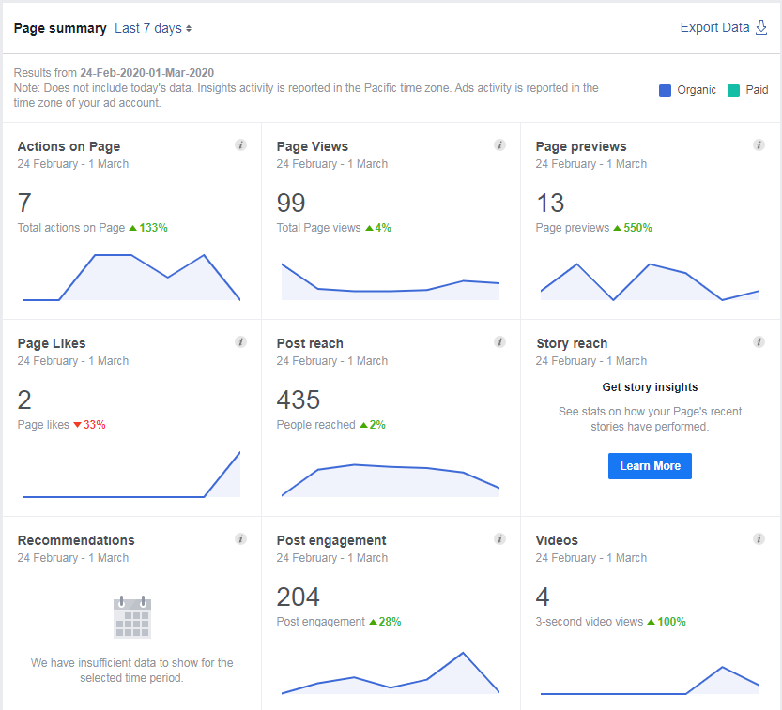

Slide 16
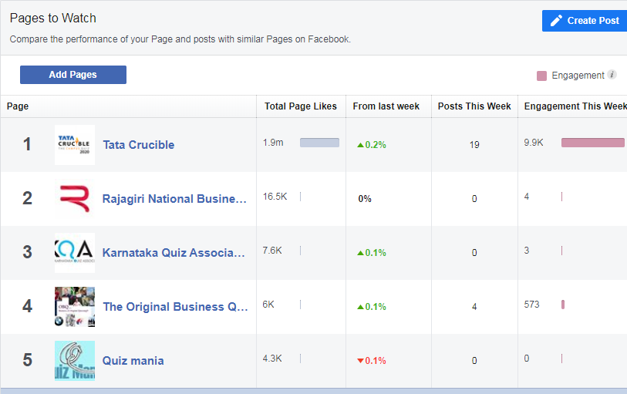

Slide 17
Collating and organising your data
A business has one or more databases – e.g. email, customer, mobile, or call centre databases.
CRM software can be used to automate lead and sales processes, and to collect all of this customer information in a centralised place, allowing a company to get a holistic view of the customer – from this, meaningful data insights can emerge.
SalesForce (www.salesforce.com), Genius (www.genius.com) and Highrise (www.highrisehq.com)

Slide 18
Keeping data fresh
For generic data (like web analytics), you must continuously monitor trends and note what causes changes over time.
This is also useful for monitoring trends and identifying gaps in data when a business evolves.
Keeping identifiable data current means you need to facilitate regular dialogue with contacts on your database. Whether it’s through a call centre, an online prompt or a quick question at your in-store point of sale, there needs to be a plan for updating details at regular intervals.

Slide 19
Analysing data for marketing
Analysing CRM data can aid marketing initiatives in a variety of ways:
Campaign analysis – find out which marketing campaigns are leading to the best returns so you can refine them and increase ROI
Personalisation – customise your communications to each customer
Event monitoring – tie offline events, like shows or sales, to your online interactions and sales
Predictive modelling – predict a customer’s future behaviour and meet this need at the right time
Improved customer segmentation

Slide 20
The benefits of CRM
Increased revenue and profitability
Improved customer satisfaction and loyalty
Improved service delivery and operational efficiencies
Decreased acquisition costs – keeping churn low through CRM offsets the need to spend as much on acquisition of new clients, while retention of existing ones is cheaper for obvious reasons

Slide 21
Putting a value on CRM
A marketing perspective – increasing the number of people who know about your service or product
A cost perspective – decreasing the amount you spend on customers; it costs more to attract a new customer than maintain an existing one
A sales perspective – turning the people who know about your service or product into people who have made a purchase
A service perspective – ensuring people who have interacted with you are satisfied and delighted.

Slide 22
Social CRM
The convergence of social media with CRM has been termed social CRM or CRM 2.0, and has developed into a field on its own.

Slide 23
Step-by-step guide to implementing a CRM strategy
Step 1 – Conduct a business needs analysis
Step 2 – Understand customer needs
Step 3 – Set objectives and measurements of success
Step 4 – Determine how you will implement CRM
Step 5 – Choose the right tools

Slide 24
Tools of the trade
Collaborative CRM tools
MindTouch (www.mindtouch.com)
Social CRM tools
BrandsEye (www.brandseye.com), Radian6 (www.radian6.com) and Simplify360 (www.simplify360.com)
Operational CRM tools
OnContact (www.oncontact.com) and Zoho CRM (www.zoho.com/crm)
Sales and marketing automation CRM tools
HubSpot (www.hubspot.com)
Analytical CRM tools
KXEN (www.kxen.com)

Slide 25
Search Engine Optimisation (SEO)

Slide 26
Search engine optimisation (SEO) is the practice of optimising a website to achieve the highest possible ranking on the search engine results pages (SERPs).
Google says it uses more than 200 different factors in its algorithm to determine relevance and ranking
SEO can be split into two distinct camps: white hat SEO and black hat SEO
SEO is a fundamental part of digital marketing because people conduct trillions of searches every year, often with commercial intent to find information about products and services
Search engines work by crawling hundreds of billions of pages using their own web crawlers. These web crawlers are commonly referred to as search engine bots or spiders

Slide 27
Terminologies
Alt text: The ‘alt’ attribute for the IMG HTML tag. It is used in HTML to attribute a text field to an image on a web page, normally with a descriptive function, telling a search engine or user what an image is about and displaying the text in instances where the image is unable to load. Also called Alt Tag.
Anchor text: The visible, clickable text in a link.
App store optimization (ASO): The process of optimizing mobile and web applications for the specific web stores in which they are distributed.
Backlink: All the links on other pages that will take the user to
a specific web page. Each link to that specific page is
known as an inbound/backlink. The number of backlinks
influences your ranking, so the more backlinks the
better – get linking!
Canonical The canonical version is the definitive version. In SEO, it refers to a definitive URL

Slide 28
Domain name: The easy-to-read name used to identify an IP address of a server that distinguishes it from other systems on the World Wide Web: our domain name is quirk.biz.
Flash: A technology used to show video and animation on a website. It can be bandwidth heavy and unfriendly to search engine spiders.
Heading tags Heading tags (H1, H2, H3, etc.) are standard elements used to define headings and subheadings on a web page. The number indicates the importance, so H1 tags are viewed by the spiders as being more important than H3 tags. Using target key phrases in your H tags is essential for effective SEO.
Home page The first page of any website. The home page gives users a glimpse into what your site is about – very much like the index in a book, or a magazine

Slide 29
Hypertext Markup Language (HTML): Certain HTML tags are used to structure the information and features within a web page.
Hyperlink A link in an electronic document that allows you, once you click on it, to follow the link to the relevant web page.
Internet Protocol (IP) address: The Internet Protocol (IP) address is an exclusive number that is used to represent every single computer in a network
Keyword frequency: The number of times a keyword or key phrase appears on a website.
Key phrase: Two or more words that are combined to form a search query - often referred to as keywords. It is usually better to optimise for a phrase rather than a single word.
Keyword rankings: Where the keywords or phrases targeted by SEO rank in the search engine results – if your targeted terms do not appear on the first three pages, start worrying.
Landing page: The page a user reaches when clicking on a paid or organic search engine listing. The pages that have the most success are those that match up as closely as possible with the user’s search query

Slide 30
PageRank: Google’s secret algorithm for ranking web pages in search engine results pages.
Referrer When a user clicks on a link from one site to another, the site the user has left is the referrer. Most browsers log the referrer’s URL in referrer strings. This information is vital in determining which queries are being used to find specific sites
Universal Resource Locator (URL): A web address that is unique to every page on the Internet.
Usability: A measure of how easy it is for a user to complete a desired task. Sites with excellent usability fare far better than those that are difficult to use.

Slide 31
Understanding SEO
Search engines need to help users find what they’re looking for.
To make sure they list the best results first, they look for signals of:
Popularity
Authority
Relevance
Trust
Importance
SEO, also called organic or natural optimisation, involves optimising websites to achieve high rankings on search engines for certain selected key phrases.

Slide 32
How search engines work, according to Google?
“PageRank relies on the uniquely democratic nature of the web by using its vast link structure as an indicator of an individual page’s value.
In essence, Google interprets a link from page A to page B as a vote, by page A, for page B.
But Google looks at more than the sheer volume of votes, or links, a page receives; it also analyzes the page that casts the vote.
Votes cast by pages that are themselves ‘important’ weigh more heavily and help to make other pages ‘important’.”

Slide 33
SEO can be divided into two main strategies:
1. On-page optimisation is achieved by making changes to the HTML code, content and structure of a website, making it more accessible for search engines, and by extension, easier for users to find.
2. Off-page optimisation is generally focused on building links to the website, and covers activities like social media and digital PR.
SEO is an extremely effective way of generating new business to a site.
It is a continuous process and a way of thinking about how search engines see your website, and how users use search engines to find your website. It’s search psychology.

Slide 34
Search engine optimisation is a fairly technical practice but it can easily be broken down into five main areas:
A search engine friendly website structure
A well-researched list of key phrases
Content optimised to target those key phrases
Link popularity
User insights

Slide 35
Search engine friendly website structure
Search engines encounter two kinds of obstacles:
Technical challenges that prevent the search engine spider from accessing content.
A competitive marketing environment where everyone wants to rank highly.
To ensure that search engines can access your content, you must remove technical barriers.
The key is to make sure that there are direct HTML links to each page you want the search engines to index.
The most important pages should be accessible directly from the home page of your website.

Slide 36
SEO and key phrases
Key phrases are the very foundation of search.
When a user enters a query on a search engine, he or she uses the words he or she thinks are relevant to the search.
The search engine then returns those pages it believes are most relevant to the words the searcher used – and, increasingly, the implied meaning of the search.

Slide 38
Step-by-step key phrase research
Brainstorm
Gather Data
Use keyword research tools
Similar keywords
Common keywords used with that keyword
Common misspellings
Frequency of the keywords in search queries
Industry-related keywords
Keywords that are sending traffic to your competitors
How many sites are targeting your keywords

Slide 40
Optimising content for key phrases
Once keywords and phrases are selected, we need to ensure the site contains content to target them.
Here are some guidelines:
1. Title tag: use the key phrase in the title and as close to the beginning as possible.
2. H1 header tag: use the key phrase in the header tag, and as much as possible in the other H tags.
3. Body content: use the key phrase at least three times, more if there is a lot of content and it makes sense to. You should aim for about 350 words of content. But don’t overdo it! That could look like spam to the search engines.
4. Bold: use <strong> tags around the keyword at least once.
5. URL: try to use the key phrase in your page URL.
6. Meta description: use it at least once in the meta description of the page, which should entice users to click through to your site from the SERP.
7. Link anchor text: try to ensure that the keyword is used in the anchor text of the pages linking to you.
8. Domain name: if possible, use the key phrase in your domain name.

Slide 41
Link popularity
Links are a vital part of how the Internet works. The purpose of a link is to allow a user to go from one web page to another
When one page links to another, it is as if that page is voting or vouching for the destination page. Generally, the more votes a website receives, the more trusted it becomes, the more important it is deemed, and the better it will rank on search engines.

Slide 42
The parts of a link
Here is the HTML code for a link:
<a href=“http://www.targeturl.com/targetpage.htm”>Anchor Text</a>
<a href> and </a> are HTML tags that show where the link starts and ends.
http://www.targeturl.com/targetpage.htm is the page that the link leads to. You should make sure that you are linking to a relevant page in your site, and not just to the home page.
Anchor Text is the visible text that forms the link. This is the text that should contain the key phrase you are targeting.

Slide 43
How does a website get more links?
Create excellent, valuable content that others want to read

Slide 44
Create tools and documents that others want to use

Slide 45
Create games
Capitalise on software and widgets
Competitor analysis

Slide 46
User insights
Search engines want their results to be highly relevant to web users, to make sure that web users keep returning to the search engine for future searches.
And the best way to establish what is relevant to users? By looking at how they use websites.
Search engines use cookies to maintain a history of a user’s search activity. This will include keywords used, and websites visited from the search engine.
Social & search
Mobile search
Local search

